Slide 1
Open lesson in elementary school
Spotlight 3
Teacher: Tikhonova
Natalya Vladimirovna
Cheboksary, 2023

Slide 2
What picture is missing?

Slide 3
What picture is missing?
?

Slide 4
What picture is missing?
?

Slide 5
What picture is missing?
?

Slide 6
What picture is missing?
?

Slide 7
What picture is missing?
?

Slide 8
In the Park 14а
New vocabulary

Slide 9
In the Park
Drink Coke
Eat a hot dog

Slide 10
In the Park
Fly a kite
Play basketball

Slide 11
In the Park
Play soccer
Ride a bike

Slide 12
In the Park
sleep
Wear a mac

Slide 13
Drink Coke - пить колу
Eat a hot dog – есть сосиску в тесте
Fly a kite –запускать воздушного змея
Play basketball – играть в баскетбол
Play soccer - играть в футбол
Ride a bike – кататься на велосипеде
Sleep – спать
Wear a mac –надевать / носить плащ

Slide 14
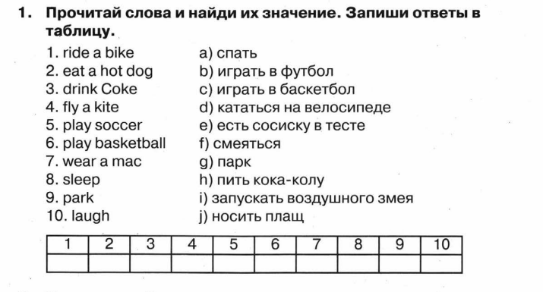
In the Park Ex.B. p.95,ex.1

Slide 15
In the Park WB p.56.ex.1

Slide 16
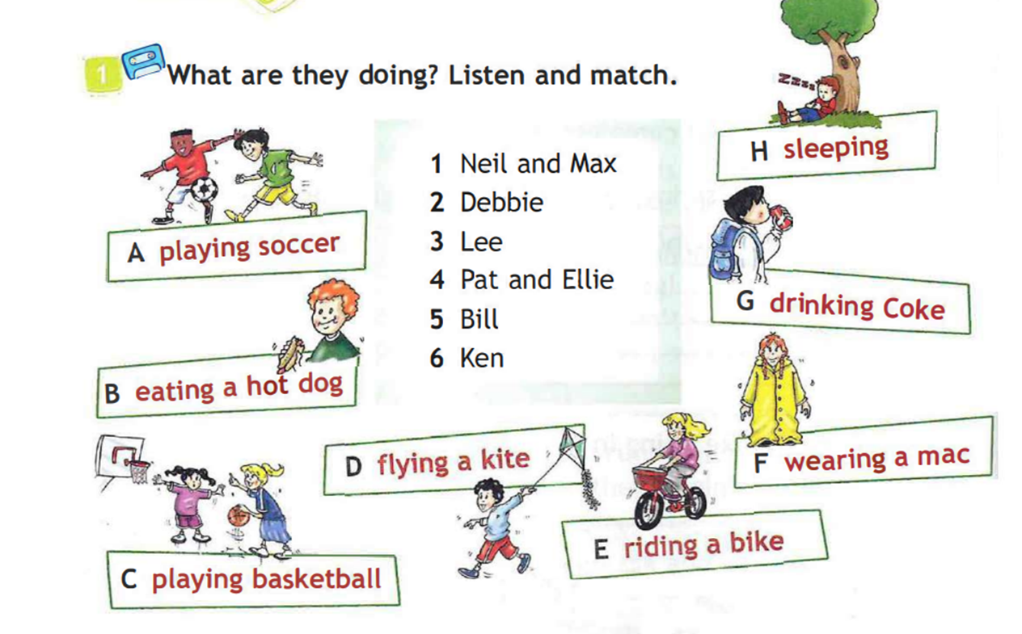
Listening
Надо поставить запись

Slide 17
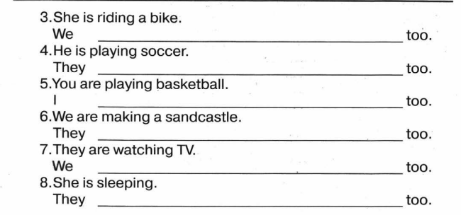

Slide 18
In the Park SB. p.110,ex.2

Slide 19
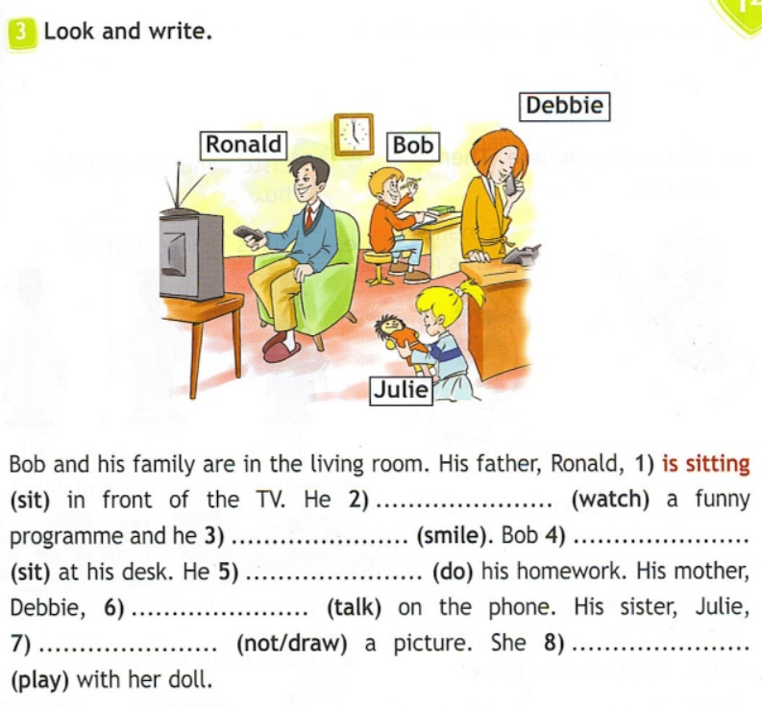
In the Park WB. p.57,ex.3

Slide 20
In the Park SB. p.111,ex.3

Slide 21
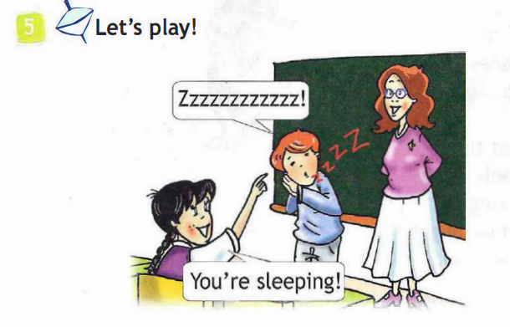
In the Park SB. p.111,ex.5
Are you + V-ing +…?
No, I am not. Yes, I am.

Slide 22
End of the lesson
Have you learnt anything new in the lesson?
Can you talk about the actions that are happening now?

Slide 23
Home work
- draw
- describe in writing

Slide 24
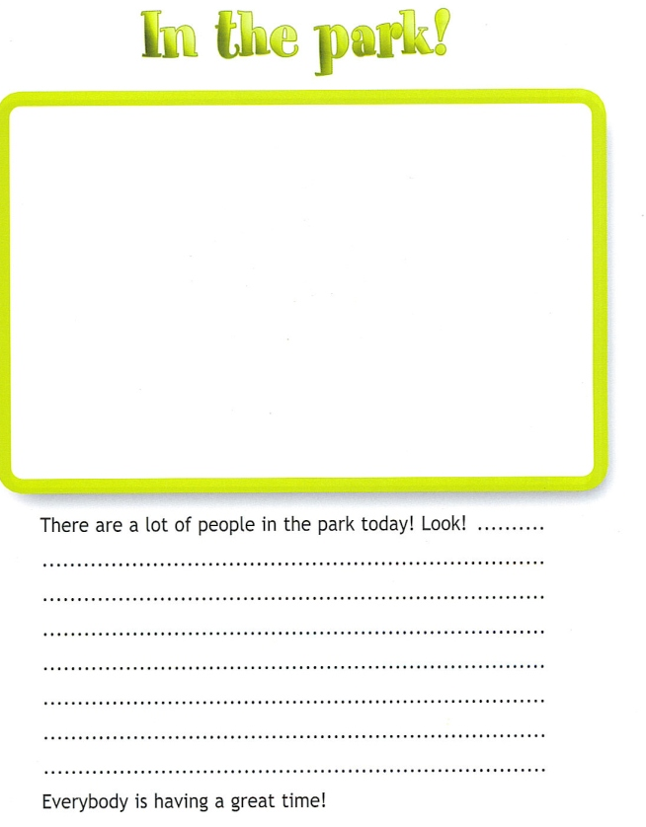
- draw -describe in writing

Slide 25
Reflection
Everything is clear, interesting
Understood, but not all

